Slide 1
CUSTOM CREATURES
Neural Network Powered Animal Image Synthesis Engine
Yihao Shu
shu.yih@northeastern.edu
(Bruce) Xianwei Long
long.xianw@northeastern.edu

Slide 2
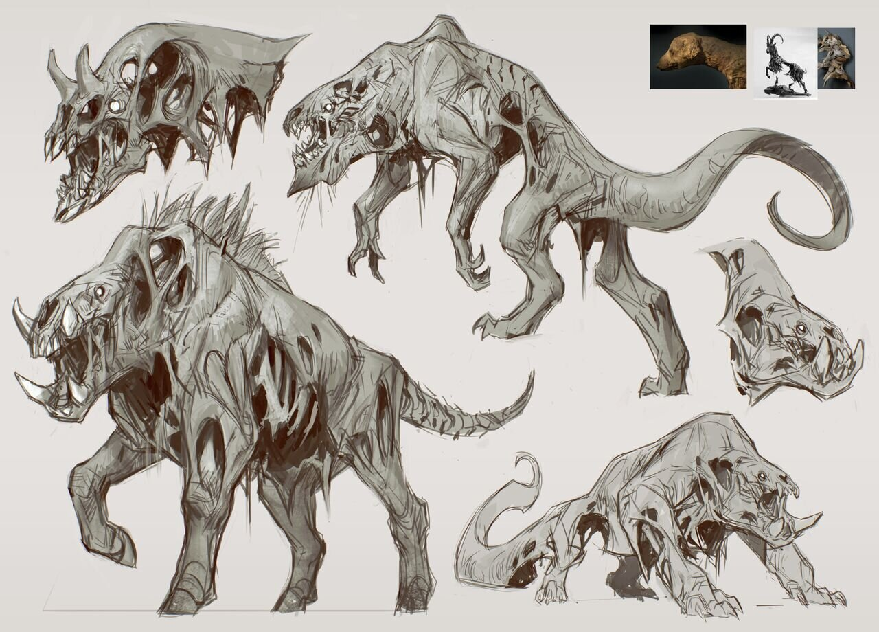
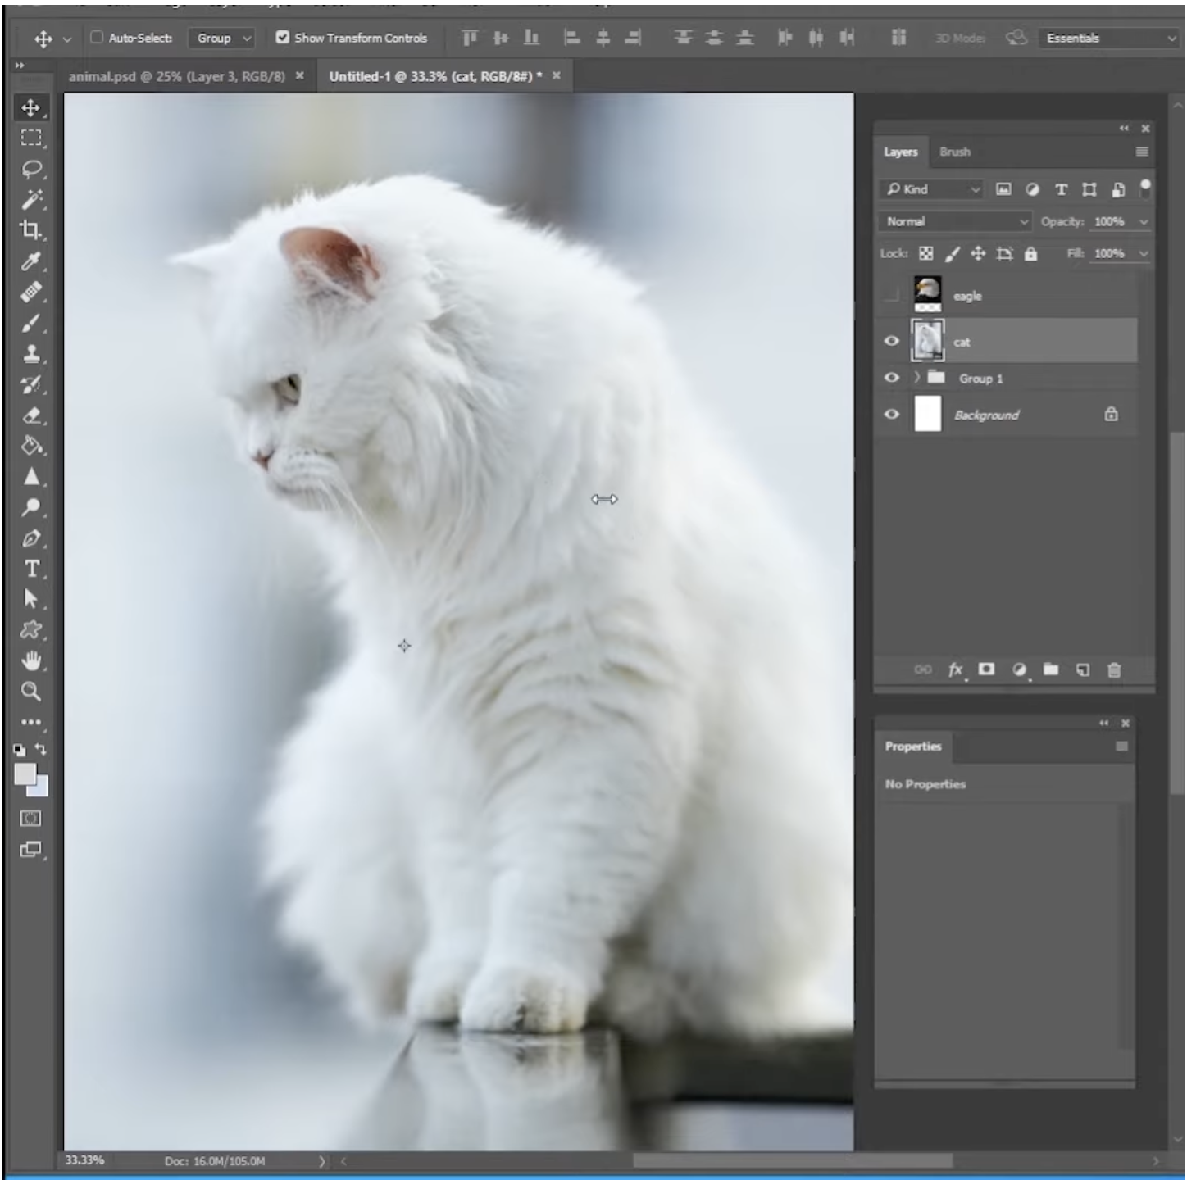
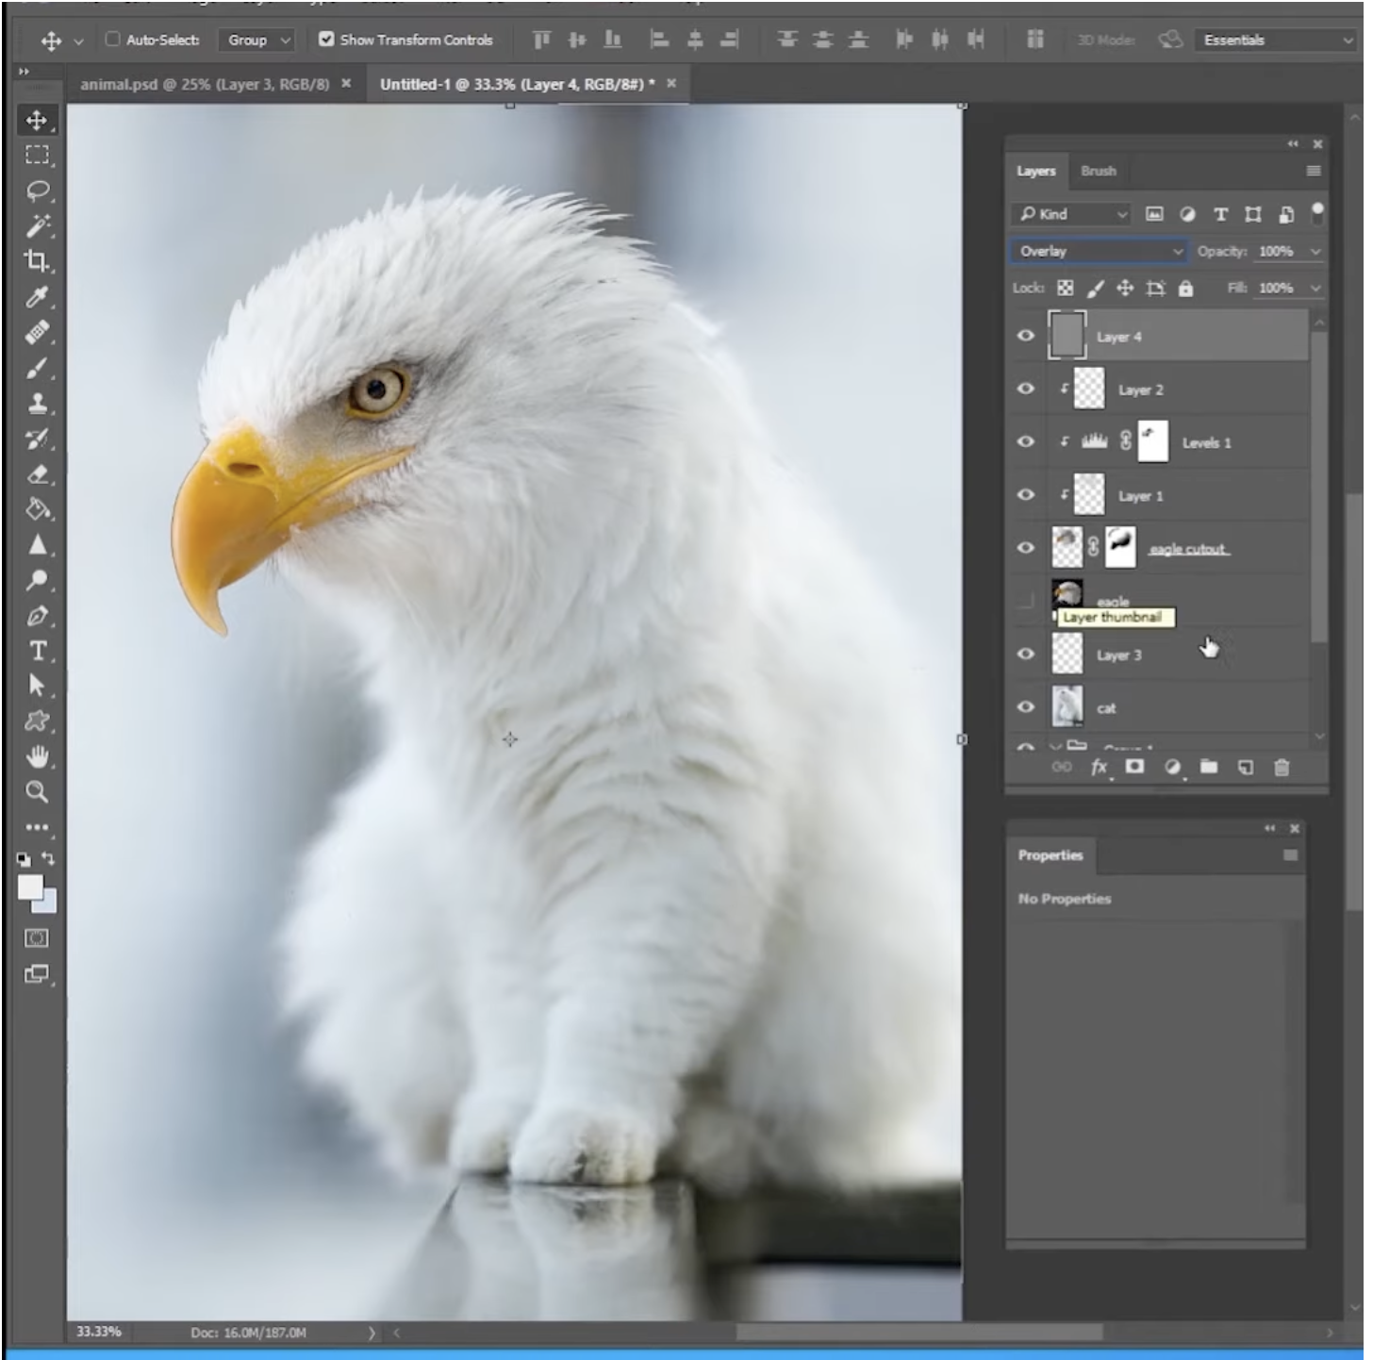
BACKGROUND
Problem
Designers are always troubled by how to generate new ideas. For example, ideas for creatures that never exists.
It takes time for designer to do even a little change when editing a picture in a “manual” way (e.g., in photoshop)
Notes:
Half min

Slide 3
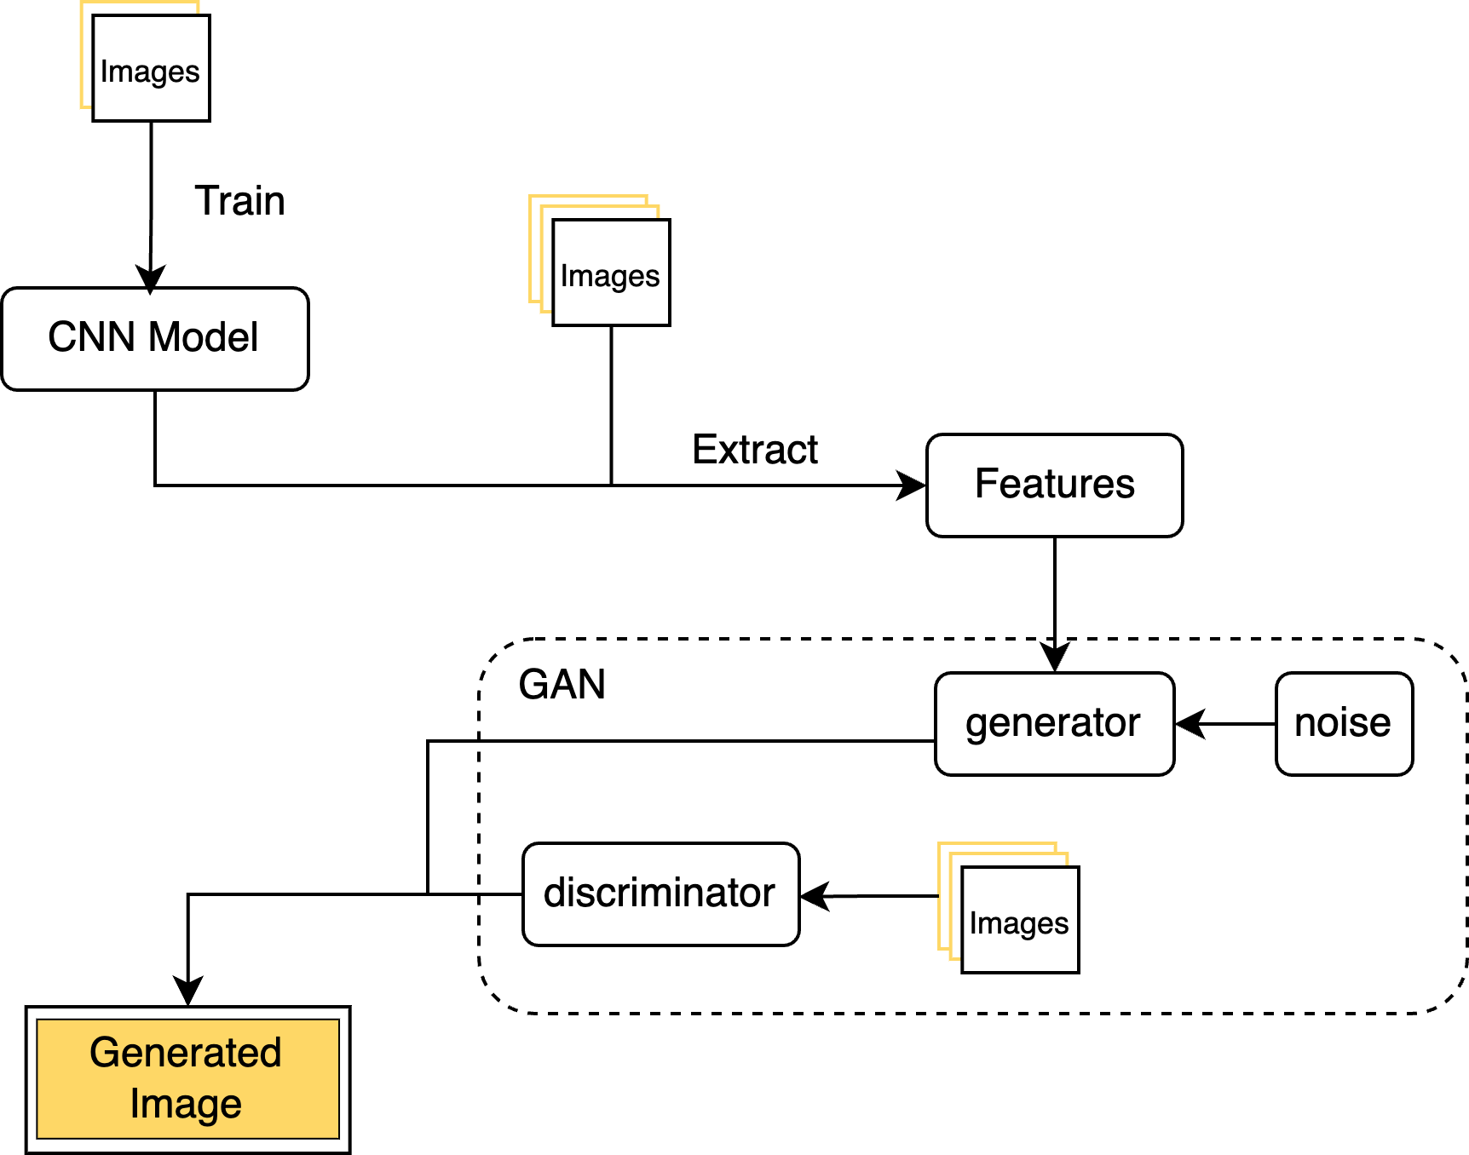
BACKGROUND
Potential Solution
: What we plan to do
Notes:
1min

Slide 4
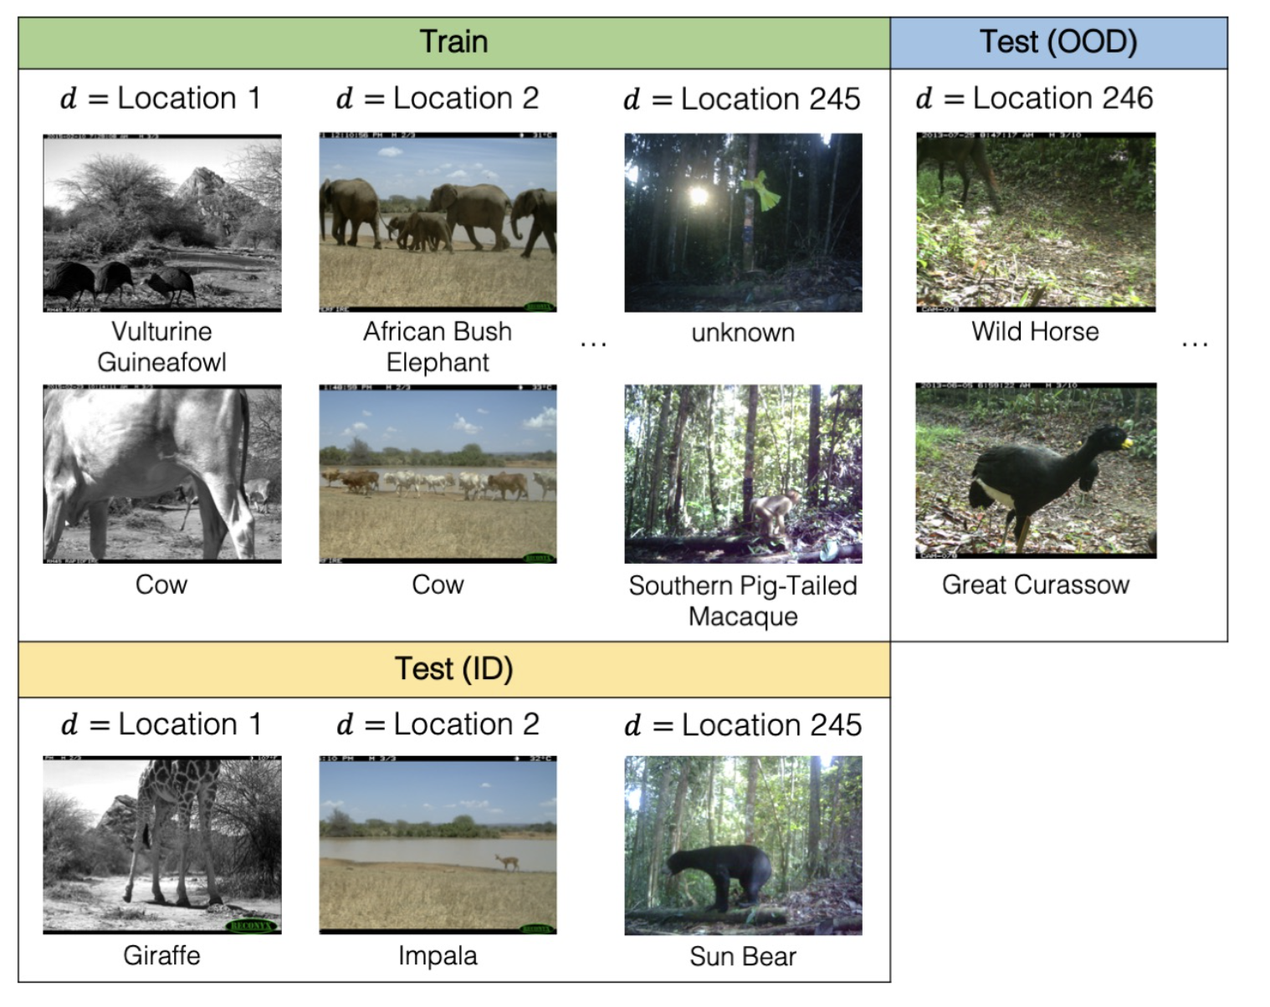
STEP1: CNN Training
Dataset
iWildCam
https://wilds.stanford.edu/datasets/
182 different animal species(labels)
245 Cameras(location)
More than 200k pictures in total

Slide 5
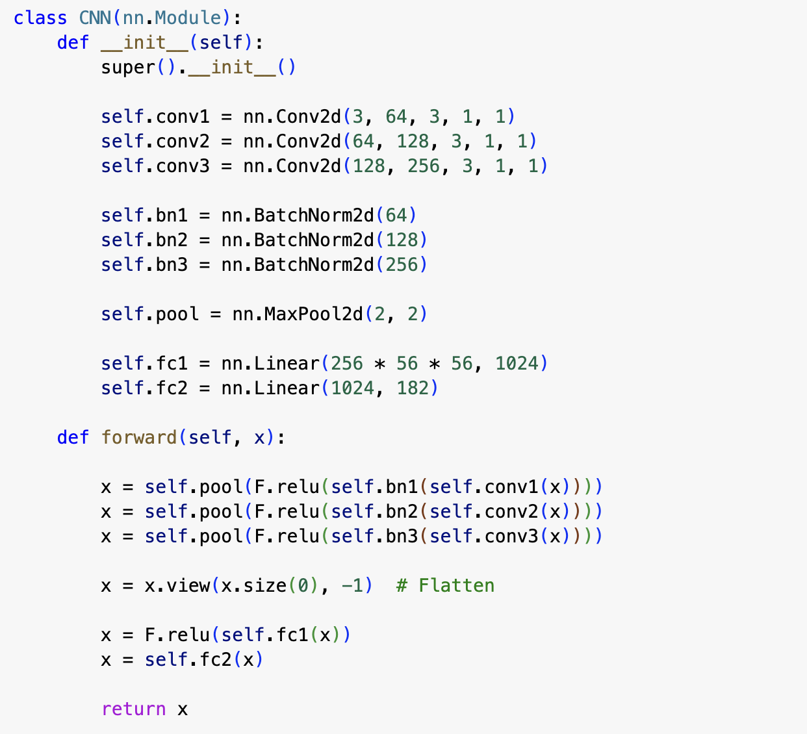
STEP1: CNN Training
CNN Model Design
A CNN Model with 5 layers
3 convolutional layers
3 batch normalization layers
2 fully-connected layers
The application of batch normalization layers can make the training process faster and more stable through normalization of the inputs by recentering and rescaling.

Slide 6
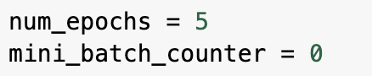
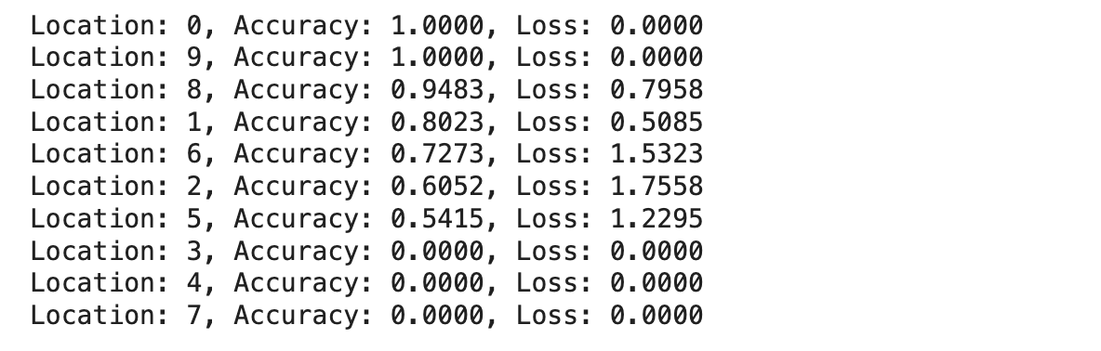
STEP1: CNN Training
Training and Testing
Train the first 10 locations
we choose location 5(which should be location 6 in dataset) to further improve the model
The accuracy is low, so we need to use some method to improve the performance before using it for the next step

Slide 7
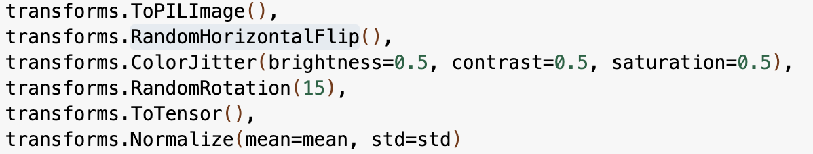
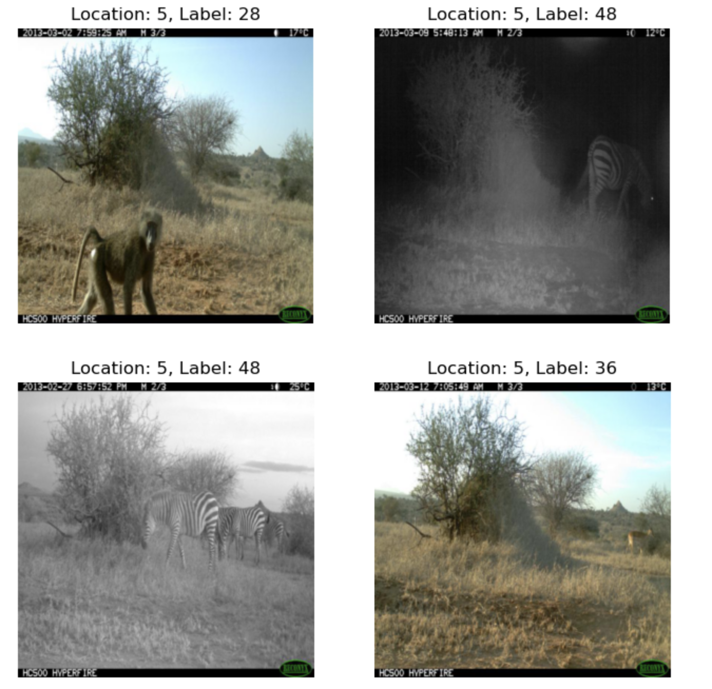
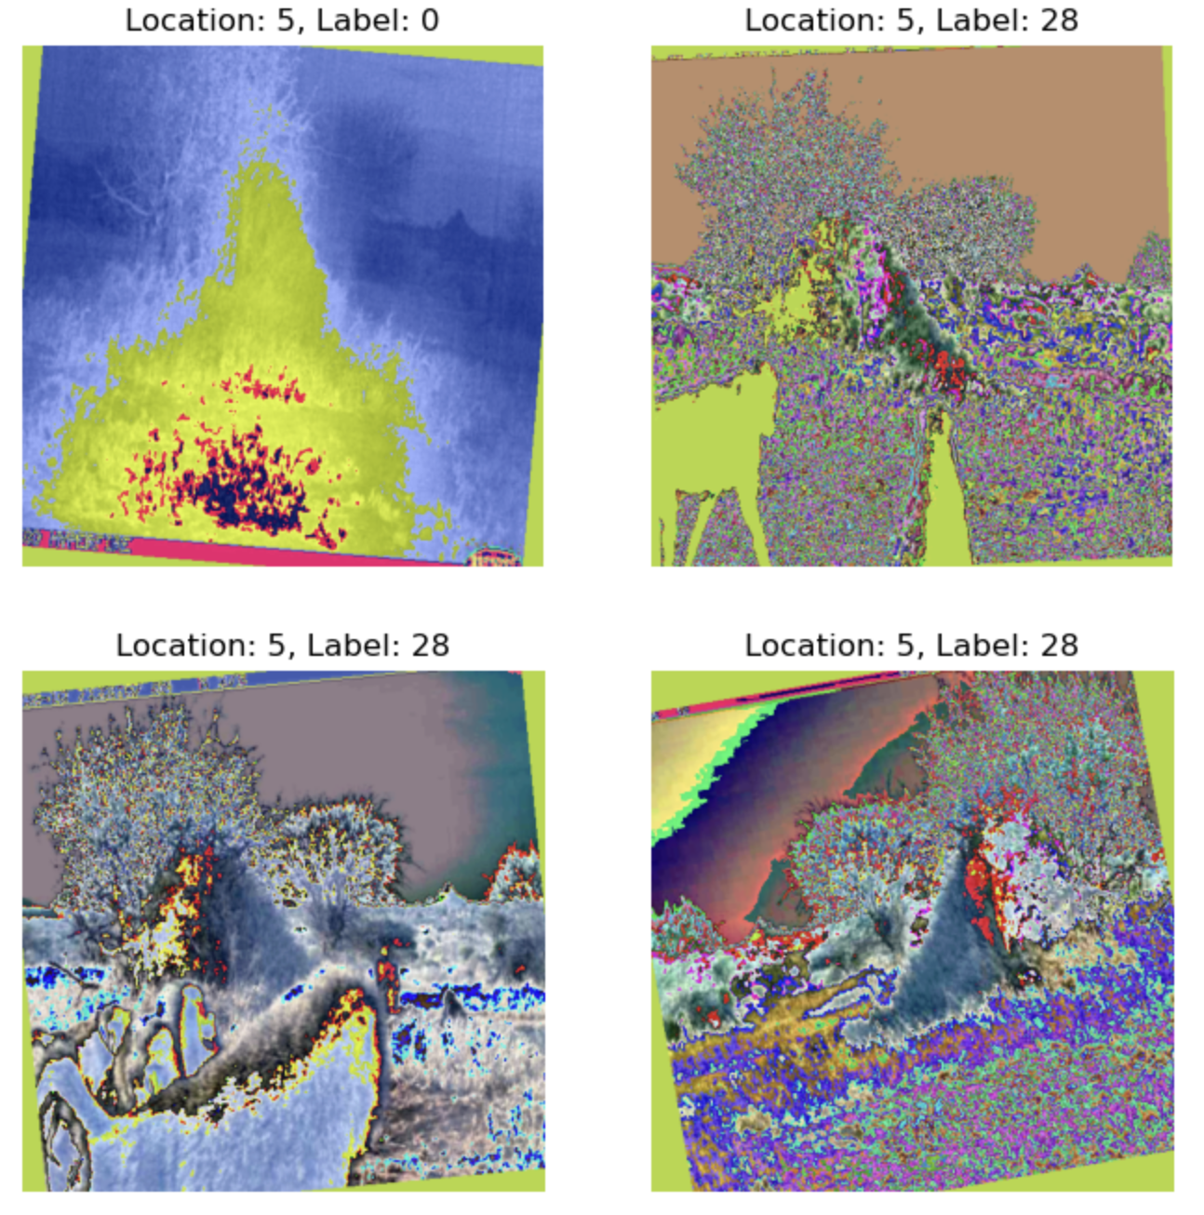
STEP2: Out of Domain
Data Augmentation
: With the image in location 5

Slide 8
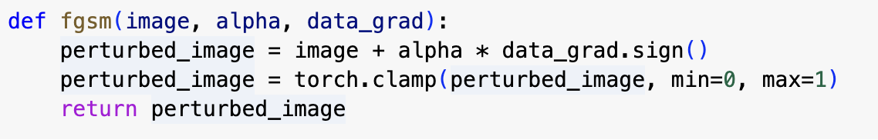
STEP2: Out of Domain
Regulation
Implement L2 regularization with a factor of 1 x 10e-5 to prevent overfitting and to help the model generalize better to unseen data.
Adversarial Training
Accuracy on adversarial test data: 0.2680
LOWER!

Slide 9
STEP2: Out of Domain
Failure Conclusion
FGSM and pick alpha = 0.1. It will cause a lot of noise in the images, the model will overfit to these noise.
Weakness of our current CNN model. It can't capture all the features in such a complex dataset.
Based on the fail experience, we will try to implement the second fine tuning OOD method by setting the alpha in adversarial training lower and choose a better model.

Slide 10
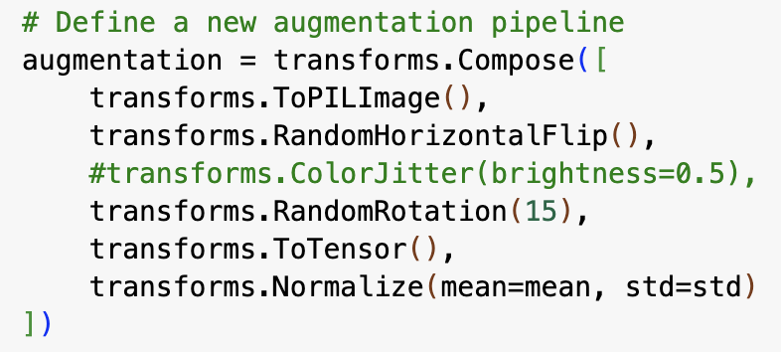
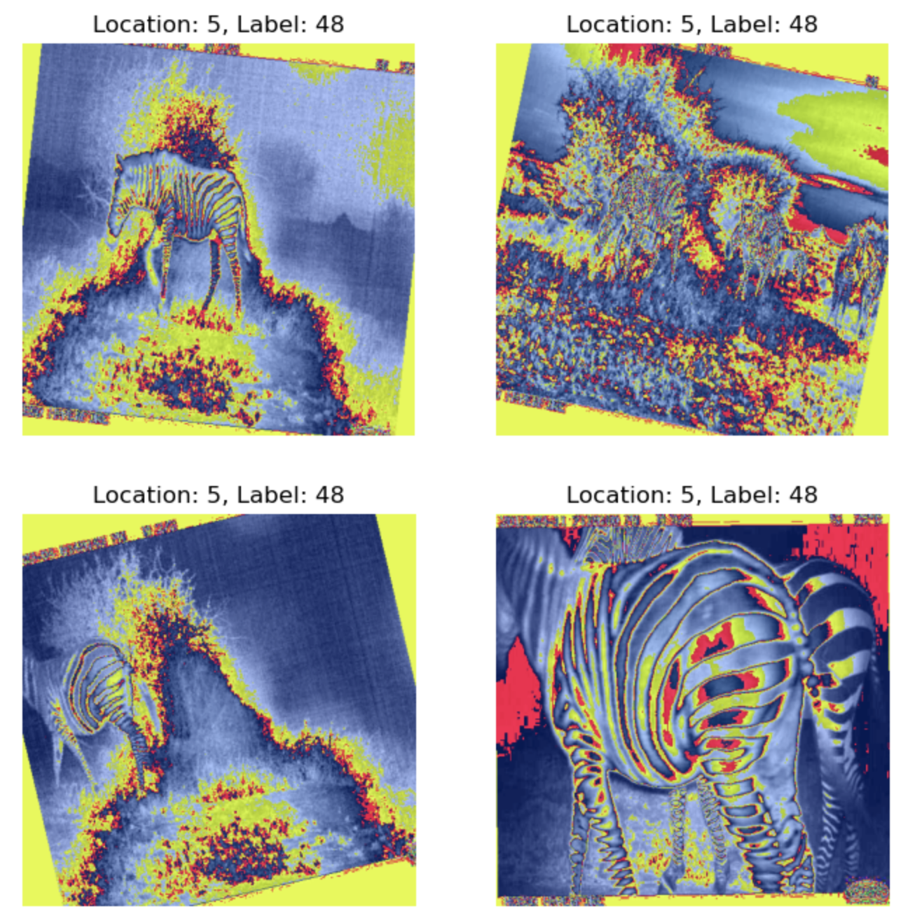
STEP2: Out of Domain
2nd Fine Tuning: Data Augmentation
Remove color jitter to reduce the noise in the images

Slide 11
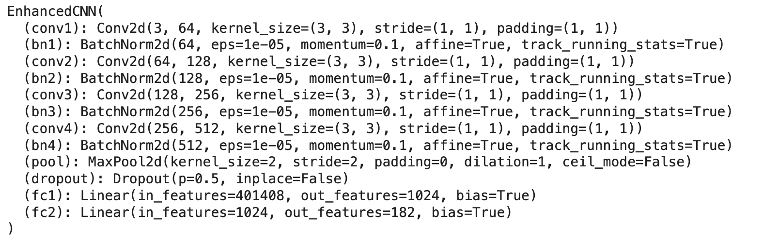
STEP2: Out of Domain
2nd Fine Tuning: Enhanced CNN Model
Key differences:
Add one more convolutional layer
Add dropout layer, to prevent overfitting

Slide 12
STEP2: Out of Domain
2nd Fine Tuning: Adversarial Training
Accuracy on adversarial test data: 0.3024
HIGHER!
This indicates the 2nd time augmented data is better, we will use them in our GAN model

Slide 13
STEP3: GAN Model
GAN Design(two neural networks):
Generator (used to create images that are indistinguishable from real images)
LeakyReLU: LeakyReLU(x)=max(αx,x), helps in ensuring that gradients do not become sparse during training, which is a common challenge in GAN
Tanh ensures that the generated images have pixel values within the same range as the real images
Discriminator
Discriminator will take an image as input and output a single value representing whether it thinks the image is real or generated.

Slide 14
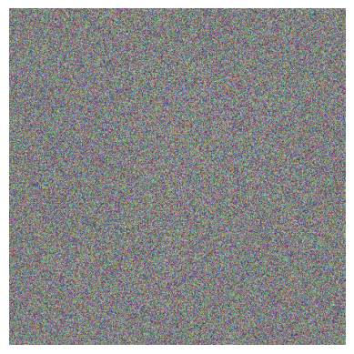
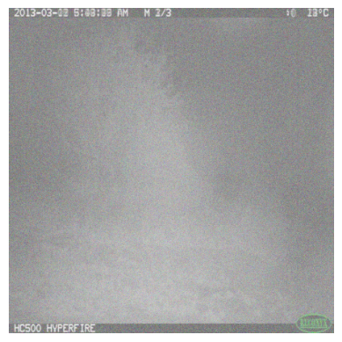
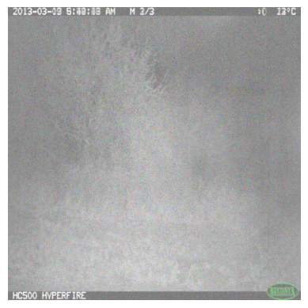
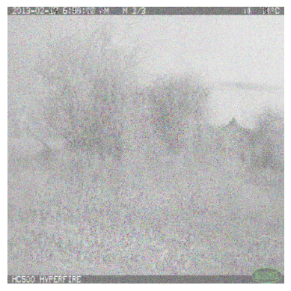
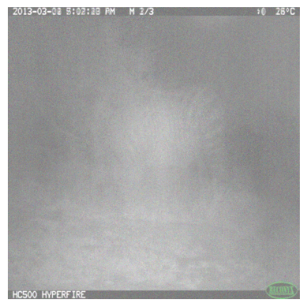
STEP3: GAN Model
Training and Generate Image
Epoch=1
Epoch=50
Epoch=175
Epoch=325
Epoch=445:

Slide 15
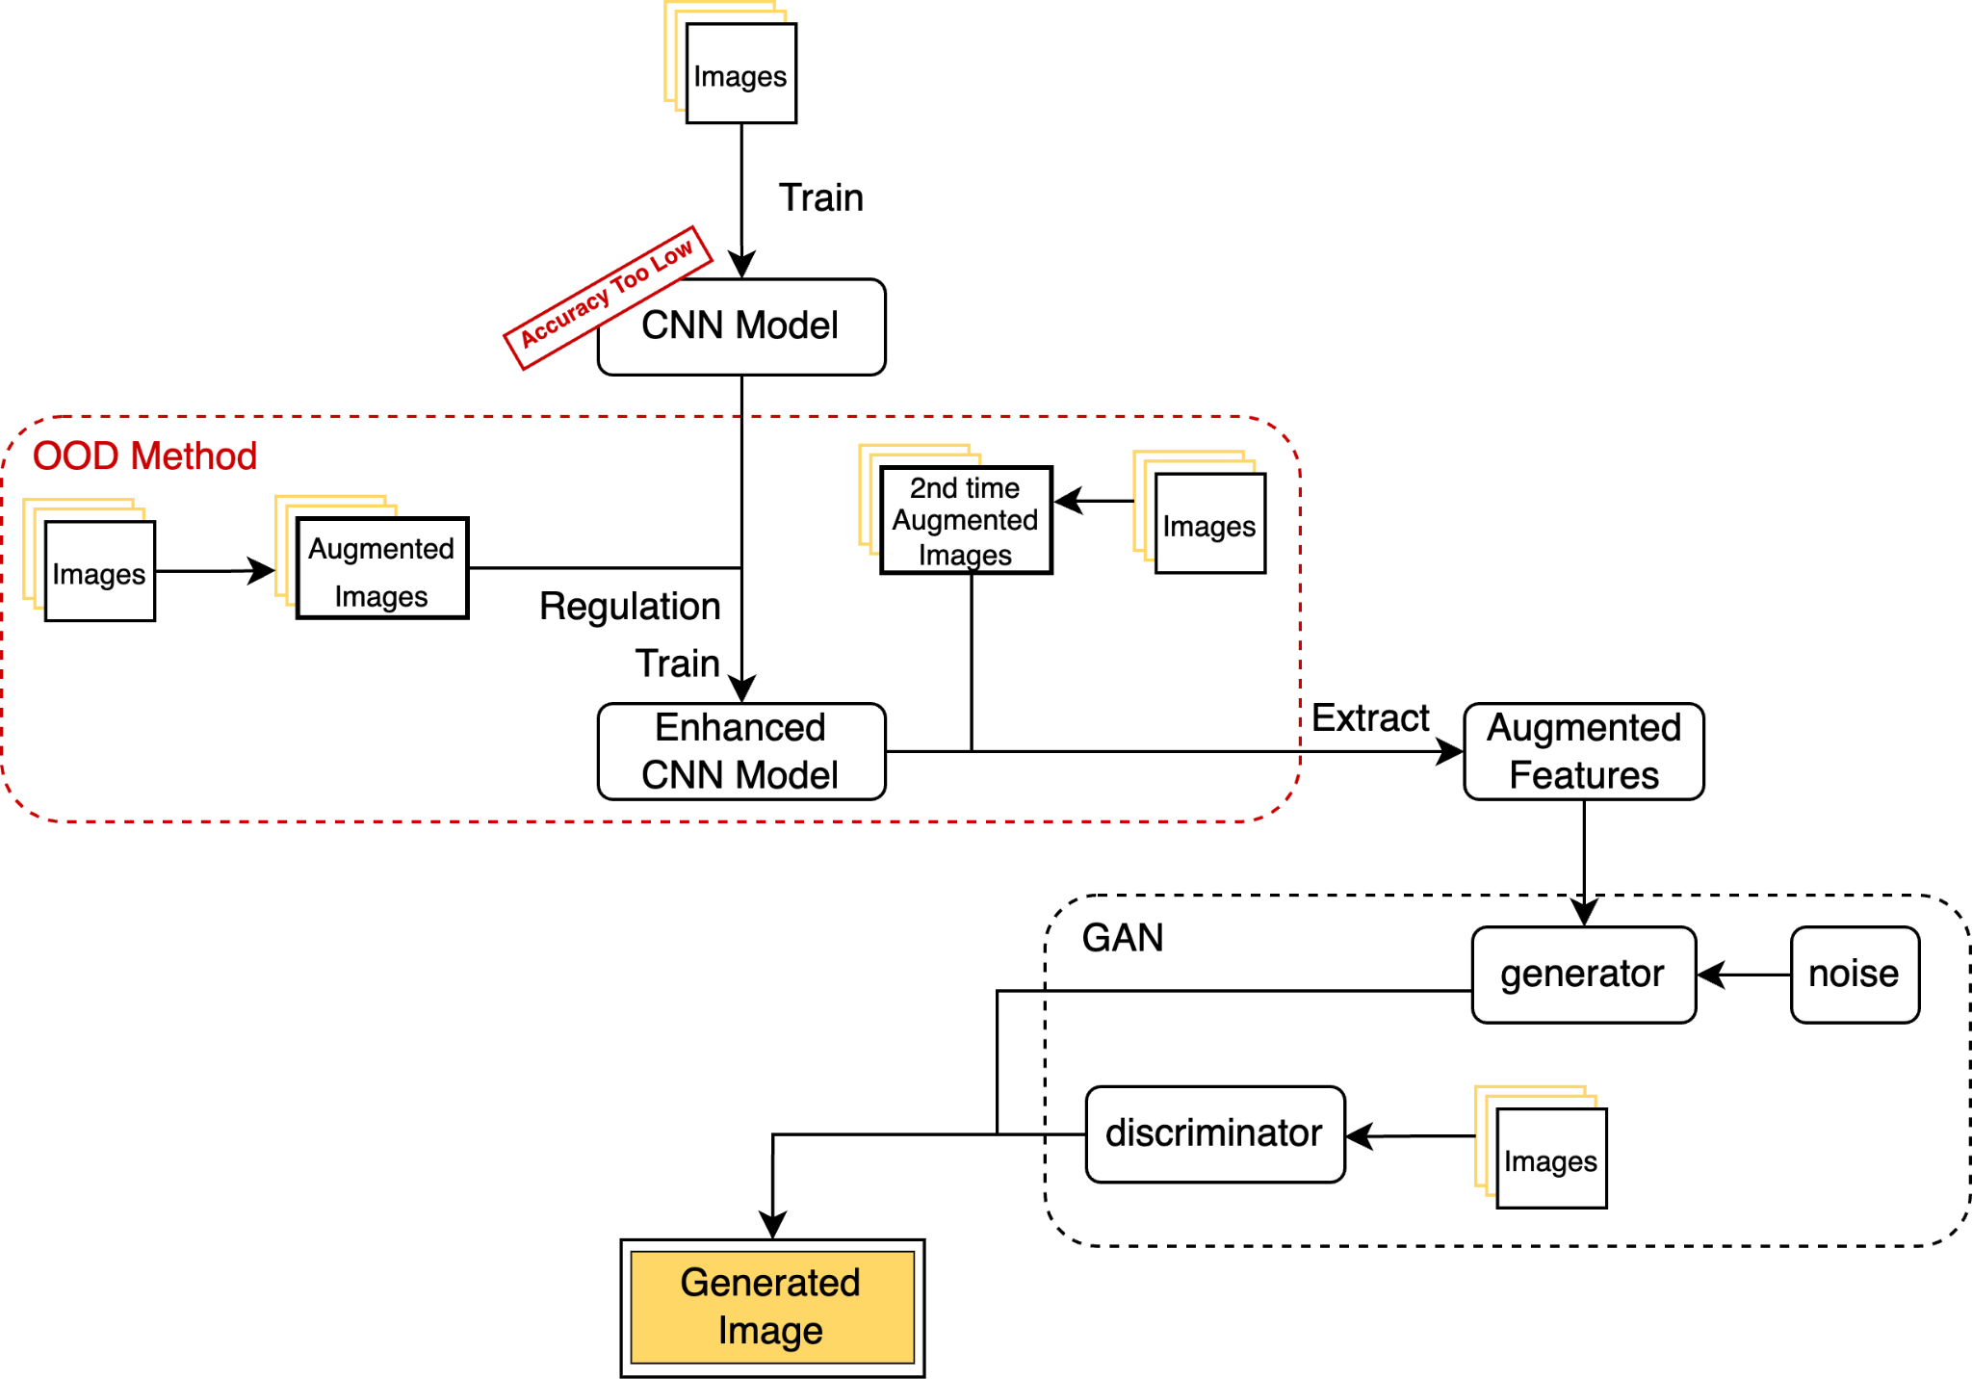
WRAP UP

Slide 16
CONCLUSION and FUTURE WORKS
Conclusion
Parameter choosing is the key to success in Neural Network model training
Due to the imperfection in choosing the proper parameters, the image generated by the model is not ideal
More epochs in training usually lead to a better model performance. It also requires more time and computational resources
Future Works
Figure out better parameters to train the model
Apply GANcycle to train the model

Slide 17
Thank You!

